Slide 1
Python workshop
Ping Pong Game
Team Name : The king slayers
Team Number : Team 18
Team mentor
Er Sathish R M.E.,(PhD).,
Assistant Professor,
Dept of IT,KiTE
Industry Mentor
Subhashini U

Slide 2
Python workshop
Ping Pong Game
Team Name : The king slayers
Team Number : Team 18
Team mentor
Er Sathish R M.E.,(PhD).,
Assistant Professor,
Dept of IT,KiTE
Team members:
* Dinesh.R (Er) [18IT10]
* Gayathri.V (Er)[18IT12]
* Enoch Philip .M.K (Er)[18IT11]

Slide 3
Title: Ping Pong Game
Problem Statement:
A simple Ping Pong Game
Ping Pong game developed
Using Pygame

Slide 4
Abstract:
Ping-pong, is a game in which two players hit a ball back and forth across a screen using paddle.The players must allow a ball played toward them to bounce one time on their side of the screen, And must return it so that it bounces on the opposite side at least once. A point is scored when a player fails to return the ball within the rules. Play is fast and demands quick reactions.the score which is equal to the times that ball hits the edge of the window.When the ball hits the wall,score will add on the screen.The game is continue untill you left the game.

Slide 5
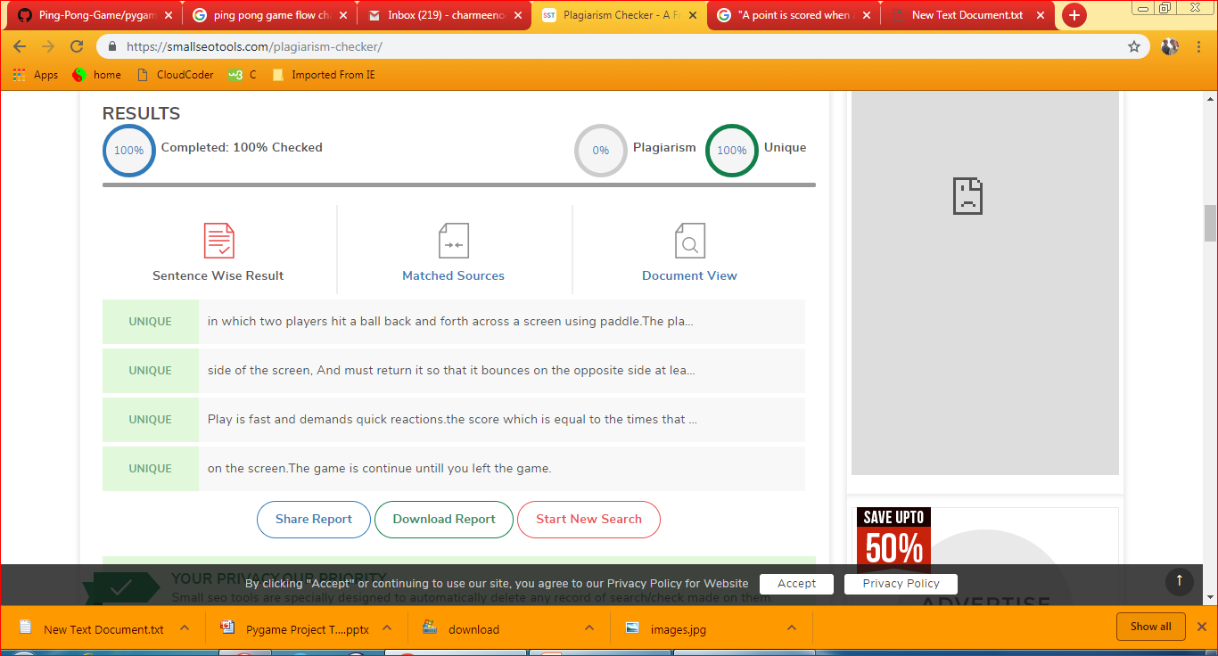

Slide 6
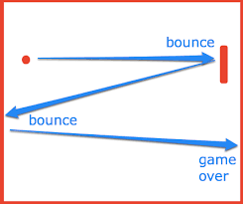
Modules:
Bouncing:
The ball will bounce around the screen in the game play.
Player Mode:
The game has two player mode.
Game Levels:
The game has an infinity level of playing.

Slide 7
Requirements
OS: Window,Mac,Linux (Any)
Hardware:
Intel pentium i5-6500 CPU
@3.20GHz ,4 GB RAM
32 or 64 bit OS
Software: Thonny
Programming Language: Python

Slide 8
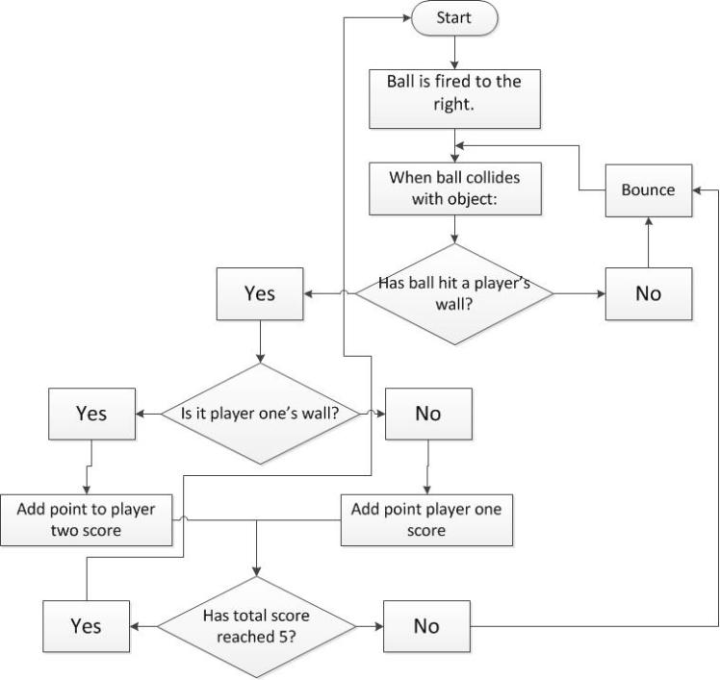
Model Architecture

Slide 9
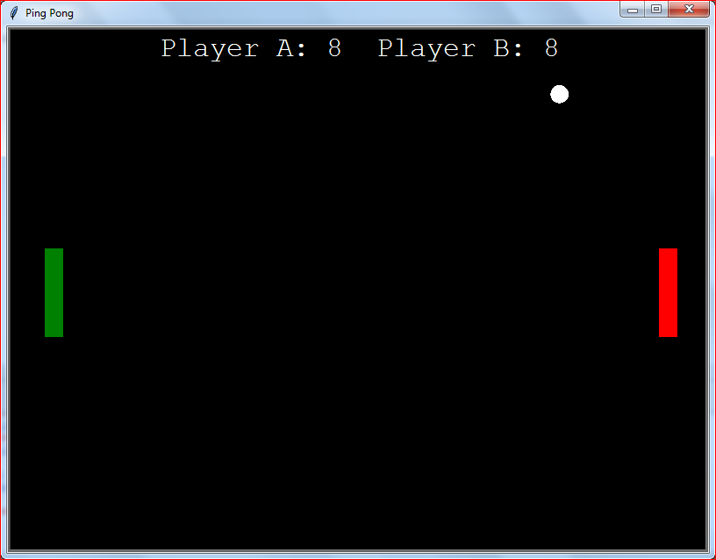

Slide 10
Thank You

